Slide 1
SpaceY Launch Cost Prediction Analysis
Predicting Falcon 9 First Stage Landing Success
IBM Data Science Professional Certificate — Capstone Project
Ryan Ordonez
GitHub: https://github.com/RyanOrdonez/spacey-capstone

Slide 2
Executive Summary
Methods Used:
• Data collected via SpaceX REST API (v4) and Wikipedia web scraping using BeautifulSoup.
• Data wrangled: missing value imputation, target variable (Class) engineering.
• EDA performed with Matplotlib, Seaborn visualizations and 10 SQL queries in SQLite.
• Interactive analytics built with Folium maps and a Plotly Dash dashboard.
• Four classification models trained with GridSearchCV (cv=10): Logistic Regression, SVM, Decision Tree, KNN.
Key Results:
• All four models achieved 83.33% test accuracy on 18 test samples.
• Decision Tree achieved the highest cross-validation score: 88.75%.
• Landing success rate improved from 0% (2010) to over 80% (2020).
• KSC LC-39A is the most successful launch site; ES-L1, GEO, HEO, SSO orbits show 100% success.
• Successful landing prediction enables competitive bidding at ~$62M vs ~$165M per launch.
GitHub: https://github.com/RyanOrdonez/spacey-capstone

Slide 3
Table of Contents
1. Executive Summary
2. Introduction
3. Data Collection — SpaceX API (Methodology)
4. Data Collection — Web Scraping (Methodology)
5. Data Wrangling (Methodology)
6. EDA with Data Visualization (Methodology)
7. EDA with SQL (Methodology)
8. Interactive Visual Analytics (Methodology)
9. Predictive Analysis (Methodology)
10. EDA Visualization Results
11. EDA with SQL Results
12. Interactive Maps — Folium Results
13. Interactive Dashboard — Plotly Dash Results
14. Predictive Analysis Results
15. Conclusion & Innovative Insights
16. Appendix

Slide 4
Introduction
Project Background
SpaceX has disrupted the rocket launch industry by
successfully landing and reusing the Falcon 9 first
stage, reducing launch cost from ~$165M to ~$62M.
Problem Statement
SpaceY, a fictional competitor, wants to predict
whether the Falcon 9 first stage will land successfully.
This prediction directly determines launch cost:
• Successful landing → ~$62M (reusable)
• Failed landing → ~$165M (expendable)
Methodology Overview
1. Data Collection (SpaceX API + Web Scraping)
2. Data Wrangling (cleaning, Class variable)
3. EDA with Visualization (Matplotlib, Seaborn)
4. EDA with SQL (SQLite, 10 queries)
5. Interactive Analytics (Folium maps, Plotly Dash)
6. Predictive Modeling (LR, SVM, DT, KNN)
Dataset: 90 Falcon 9 launches (2010–2020)
Target: Class (1 = landed, 0 = failed/no attempt)
Features: 83 columns after one-hot encoding
GitHub: https://github.com/RyanOrdonez/spacey-capstone

Slide 5
Data Collection Methodology — SpaceX REST API
API Endpoint: api.spacexdata.com/v4
Data Collection Process (Flowchart):
┌─────────────────────────────────┐
│ GET /v4/launches/past │
│ (Retrieve all past launches) │
└──────────────┬──────────────────┘
▼
┌─────────────────────────────────┐
│ Filter: rocket == Falcon 9 ID │
│ (5e9d0d95eda69973a809d1ec) │
└──────────────┬──────────────────┘
▼
┌─────────────────────────────────┐
│ For each launch, resolve IDs: │
│ • GET /v4/rockets/{id} │
│ • GET /v4/launchpads/{id} │
│ • GET /v4/payloads/{id} │
│ • GET /v4/cores/{id} │
└──────────────┬──────────────────┘
▼
┌─────────────────────────────────┐
│ Build flat DataFrame (90 × 17) │
│ Save → dataset_part_1.csv │
└─────────────────────────────────┘
Key Columns Extracted:
FlightNumber, Date, BoosterVersion
PayloadMass, Orbit, LaunchSite
Outcome (landing success + type)
Flights, GridFins, Reused, Legs
LandingPad, Block, ReusedCount, Serial
Longitude, Latitude
Outcome Column Format:
"True ASDS" → successful drone ship landing
"True RTLS" → successful ground pad landing
"False Ocean" → failed ocean landing
"None None" → no landing attempt
Tools: Python requests library
Output: data/dataset_part_1.csv (90 rows × 17 columns)
Notebook: notebooks/01_spacex_api_collection.ipynb
GitHub: https://github.com/RyanOrdonez/spacey-capstone

Slide 6
Data Collection Methodology — Web Scraping
Source: Wikipedia — List of Falcon 9 Launches
(Static HTML snapshot, June 9 2021)
Web Scraping Process (Flowchart):
┌──────────────────────────────────┐
│ requests.get(wikipedia_url) │
│ (Fetch static HTML page) │
└──────────────┬───────────────────┘
▼
┌──────────────────────────────────┐
│ BeautifulSoup(html, html.parser) │
│ Parse HTML structure │
└──────────────┬───────────────────┘
▼
┌──────────────────────────────────┐
│ Find all <table> elements │
│ Extract <th> headers → columns │
└──────────────┬───────────────────┘
▼
┌──────────────────────────────────┐
│ Iterate <tr> rows, extract cells │
│ Helper funcs: date_time, │
│ booster_version, landing_status, │
│ get_mass │
└──────────────┬───────────────────┘
▼
┌──────────────────────────────────┐
│ Dict → Pandas DataFrame │
│ Save → spacex_web_scraped.csv │
└──────────────────────────────────┘
Columns Scraped:
Flight No., Date, Time (UTC)
Version Booster, Launch site
Payload, Payload mass, Orbit
Customer, Launch outcome
Booster landing
Helper Functions:
• date_time() — parse launch date/time
• booster_version() — extract booster info
• landing_status() — parse landing outcome
• get_mass() — extract numeric payload mass
• extract_column_from_header() — get headers
Tools: requests, BeautifulSoup4
Output: data/spacex_web_scraped.csv
Notebook: notebooks/02_web_scraping.ipynb
GitHub: https://github.com/RyanOrdonez/spacey-capstone

Slide 7
Data Wrangling Methodology
Data Cleaning & Processing Steps:
Step 1: Load dataset_part_1.csv (90 rows × 17 cols)
Step 2: Identify missing values
• LandingPad: 28.9% missing (26 nulls)
• PayloadMass: minor nulls → imputed with mean
Step 3: Analyze launch frequency
• Count launches per site
• Count launches per orbit type
Step 4: Analyze landing outcome categories
• True ASDS, True RTLS → Success
• False Ocean, None None → Failure
Step 5: Engineer target variable — Class
Target Variable: Class
Class = 1 (Successful Landing)
• Outcome starts with 'True'
• True ASDS, True RTLS, True Ocean
• Count: 60 launches (66.7%)
Class = 0 (Failed / No Attempt)
• Outcome starts with 'False' or 'None'
• False ASDS, False Ocean, None None
• Count: 30 launches (33.3%)
Output: data/dataset_part_2.csv (90 rows × 18 cols)
Notebook: notebooks/03_data_wrangling.ipynb
GitHub: https://github.com/RyanOrdonez/spacey-capstone

Slide 8
EDA with Data Visualization Methodology
Charts Created and Their Purpose:
1. Flight Number vs Launch Site (scatter)
→ See which sites used over time
2. Flight Number vs Payload Mass (scatter)
→ Relationship between payload and success
3. Payload Mass vs Launch Site (scatter)
→ Payload capacity per site
4. Success Rate by Orbit Type (bar chart)
→ Which orbits have highest success
5. Flight Number vs Orbit Type (scatter)
→ Orbit selection evolution over time
6. Payload Mass vs Orbit Type (scatter)
→ Payload requirements per orbit
7. Success Rate by Launch Site (bar chart)
→ Compare site reliability
8. Yearly Success Trend (line chart)
→ Track improvement over time
Feature Engineering:
• One-hot encoding of categorical columns:
Orbit, LaunchSite, LandingPad, Serial
• Cast all features to float64
• Result: 90 rows × 83 feature columns
Tools: Matplotlib, Seaborn
Output:
• 8 PNG charts saved to images/
• data/dataset_part_3.csv (engineered features)
Notebook: notebooks/04_eda.ipynb
GitHub: https://github.com/RyanOrdonez/spacey-capstone

Slide 9
EDA with SQL Methodology
SQL Queries Performed (10 queries in SQLite):
Q1: SELECT DISTINCT Launch_Site — unique launch sites
Q2: SELECT * WHERE Launch_Site LIKE 'CCA%' LIMIT 5 — filter by site prefix
Q3: SELECT SUM(PAYLOAD_MASS__KG_) WHERE Customer = 'NASA (CRS)' — total payload for customer
Q4: SELECT AVG(PAYLOAD_MASS__KG_) WHERE Booster_Version LIKE 'F9 v1.1%' — avg payload for booster
Q5: SELECT MIN(Date) WHERE Landing_Outcome = 'Success (ground pad)' — first ground pad landing
Q6: SELECT Booster_Version WHERE Landing_Outcome = 'Success (drone ship)' AND PAYLOAD 4000-6000
Q7: SELECT Mission_Outcome, COUNT(*) GROUP BY Mission_Outcome — mission outcome counts
Q8: SELECT Booster_Version WHERE PAYLOAD_MASS = MAX — max payload boosters
Q9: SELECT * WHERE Landing_Outcome = 'Failure (drone ship)' AND Date LIKE '2015%' — 2015 failures
Q10: SELECT Landing_Outcome, COUNT(*) WHERE Date BETWEEN 2010-2017 ORDER BY COUNT — rankings
Database: SQLite | Table: SPACEXTABLE | Loaded from dataset_part_2.csv
SQL script: sql/spacex_queries.sql
Notebook: notebooks/05_sql_analysis.ipynb
GitHub: https://github.com/RyanOrdonez/spacey-capstone

Slide 10
Interactive Visual Analytics Methodology
Folium Interactive Maps:
Map 1: Launch Site Map
• Mark all 4 launch sites with circles
• Color-code markers: green=success, red=fail
• MarkerCluster for interactive exploration
• Popup labels with site name + class
Map 2: KSC LC-39A Proximity Analysis
• Calculate distance to coastline (~1.2 km)
• Calculate distance to highway (~7.1 km)
• Calculate distance to railway (~5.7 km)
• Calculate distance to city (~52 km)
• Draw lines and markers on map
Output: output/launch_site_map.html
Output: output/ksc_proximity_map.html
Notebook: notebooks/06_interactive_visuals.ipynb
Plotly Dash Dashboard:
Dashboard Components:
1. Dropdown: Select launch site (or All Sites)
2. Pie Chart: Success vs Failure for site
3. Range Slider: Filter by payload mass (0-10,000 kg)
4. Scatter Plot: Payload vs Outcome by Booster
Implementation:
• Framework: Plotly Dash
• Two reactive @app.callback decorators
• Input: site dropdown + payload slider
• Output: pie chart + scatter chart
• Data: spacex_launch_dash.csv (IBM Cloud)
Run: python dash/spacex_dash_app.py
Open: http://localhost:8050
Script: dash/spacex_dash_app.py
GitHub: https://github.com/RyanOrdonez/spacey-capstone

Slide 11
Predictive Analysis Methodology
Data Preparation:
• Target Y from dataset_part_2.csv (Class column)
• Features X from dataset_part_3.csv (83 cols)
• StandardScaler normalization
• Train/Test split: 80/20 (random_state=2)
• Train: 72 samples | Test: 18 samples
Models Trained:
1. Logistic Regression
C: [0.01, 0.1, 1], penalty: l2
2. Support Vector Machine (SVM)
kernel: [linear, rbf, poly, sigmoid]
C: logspace(-3,3,5), gamma: logspace(-3,3,5)
3. Decision Tree Classifier
criterion: [gini, entropy], max_depth: [2-18]
4. K-Nearest Neighbors (KNN)
n_neighbors: [1-10], p: [1,2]
Hyperparameter Tuning:
• GridSearchCV with cv=10
• Exhaustive search over parameter grids
• Best params selected by CV accuracy
Evaluation Metrics:
• Cross-validation accuracy (10-fold)
• Test set accuracy
• Confusion matrix (True/False Pos/Neg)
• Side-by-side model comparison bar chart
Tools: scikit-learn
GridSearchCV, StandardScaler,
confusion_matrix, accuracy_score
Notebook: notebooks/07_modeling.ipynb
GitHub: https://github.com/RyanOrdonez/spacey-capstone

Slide 12
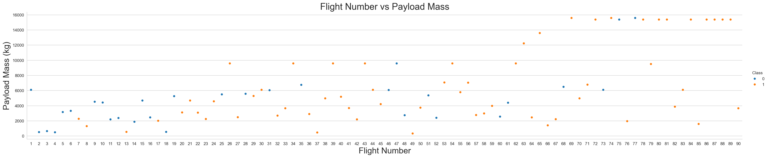
EDA Results — Flight Number vs Payload Mass (Scatter Plot)
Higher flight numbers correlate with more successful landings. Payload mass alone does not determine landing outcome.
GitHub: https://github.com/RyanOrdonez/spacey-capstone

Slide 13
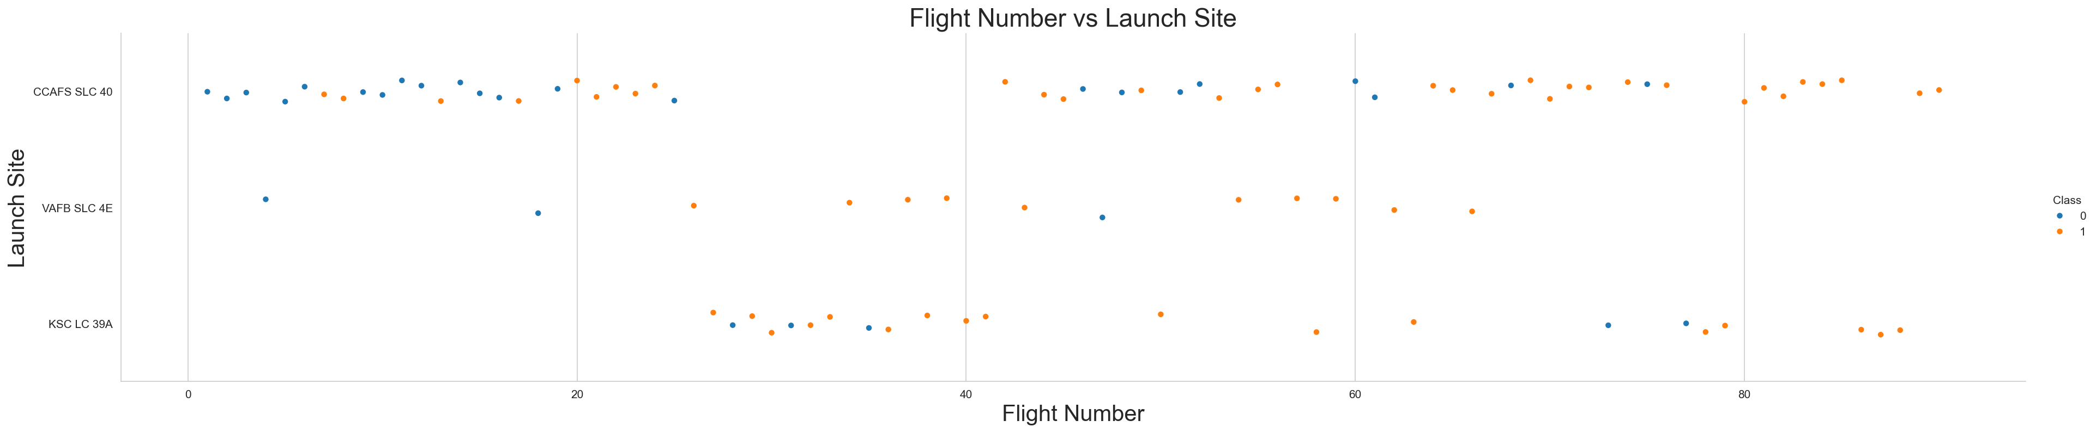
EDA Results — Flight Number vs Launch Site (Scatter Plot)
KSC LC-39A has the most launches and highest success concentration at higher flight numbers. VAFB SLC-4E used mainly for polar orbits.
GitHub: https://github.com/RyanOrdonez/spacey-capstone

Slide 14
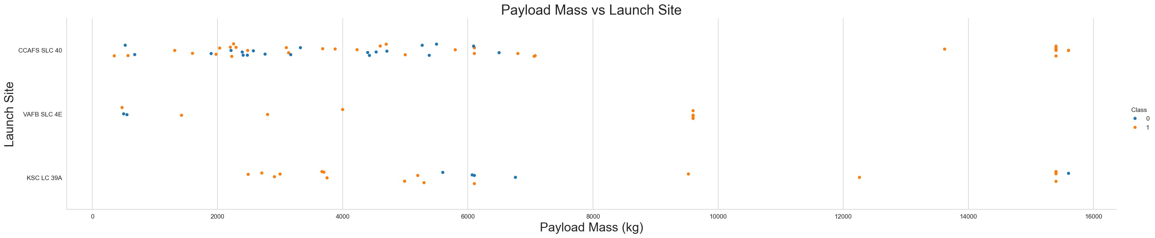
EDA Results — Payload Mass vs Launch Site (Scatter Plot)
KSC LC-39A handles the heaviest payloads (up to 15,600 kg). All sites show successful launches across payload ranges.
GitHub: https://github.com/RyanOrdonez/spacey-capstone

Slide 15
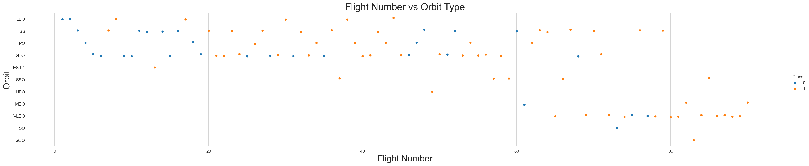
EDA Results — Flight Number vs Orbit Type (Scatter Plot)
LEO and ISS are the most common orbits in early flights. GTO missions appear throughout the timeline.
GitHub: https://github.com/RyanOrdonez/spacey-capstone

Slide 16
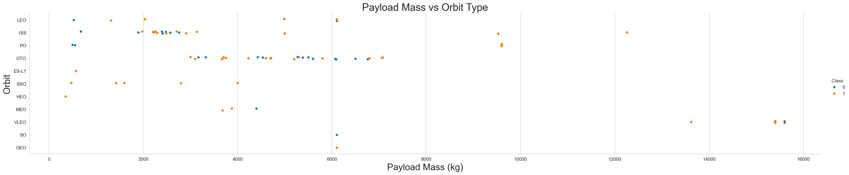
EDA Results — Payload Mass vs Orbit Type (Scatter Plot)
GTO and GEO orbits typically require higher payload masses. LEO/ISS orbits show wider payload mass ranges.
GitHub: https://github.com/RyanOrdonez/spacey-capstone

Slide 17
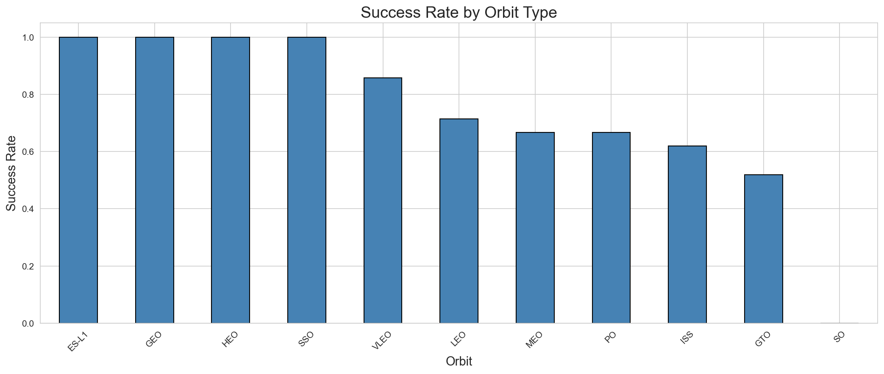
EDA Results — Success Rate by Orbit Type (Bar Chart)
ES-L1, GEO, HEO, and SSO orbits show 100% landing success. GTO has mixed results due to higher energy requirements.
GitHub: https://github.com/RyanOrdonez/spacey-capstone

Slide 18
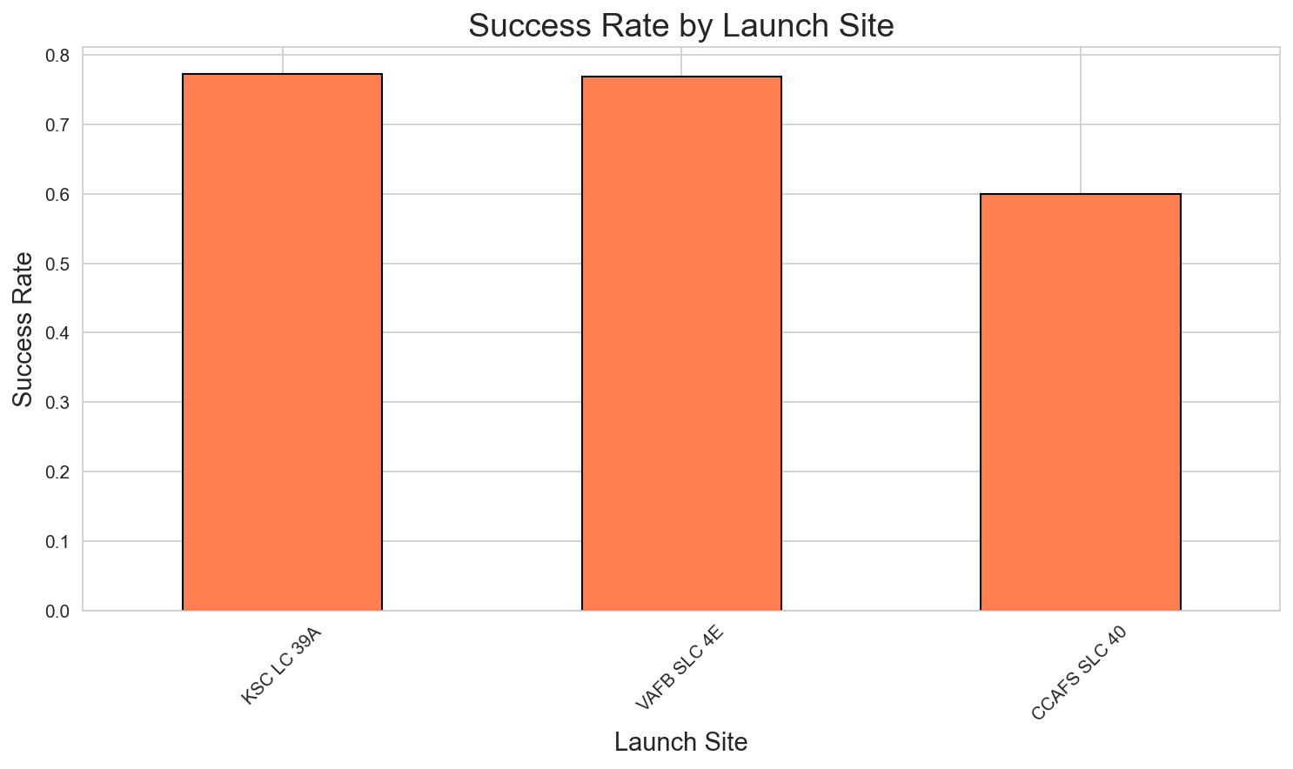
EDA Results — Success Rate by Launch Site (Bar Chart)
KSC LC-39A leads with the highest success rate. All sites show improvement over time.
GitHub: https://github.com/RyanOrdonez/spacey-capstone

Slide 19
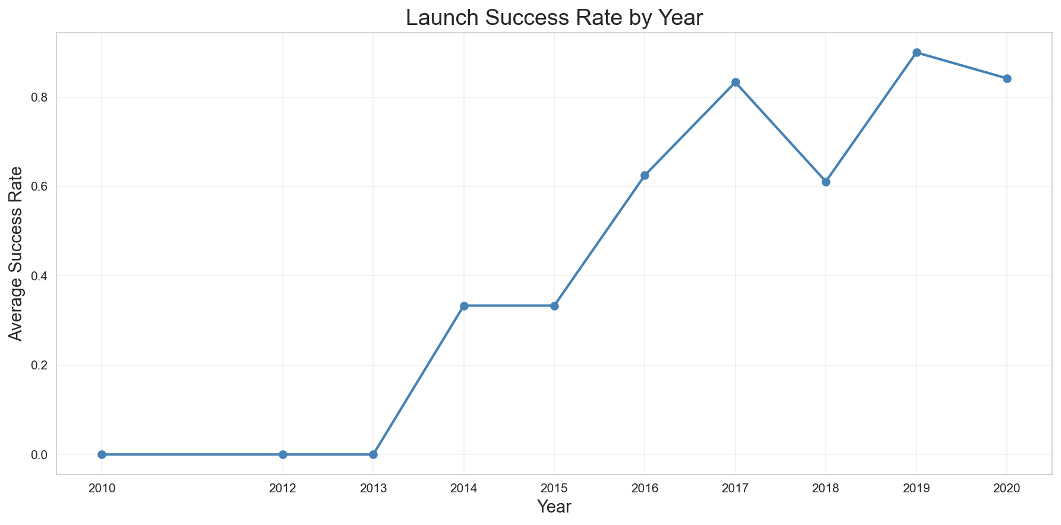
EDA Results — Yearly Success Trend (Line Chart)
Success rate improved from 0% in 2010 to over 80% by 2019–2020, demonstrating SpaceX's engineering learning curve.
GitHub: https://github.com/RyanOrdonez/spacey-capstone

Slide 20
EDA with SQL Results — Launch Sites, Payloads, Success Rates
Q1: Unique Launch Sites
CCAFS LC-40, CCAFS SLC-40, KSC LC-39A, VAFB SLC-4E
Q2: Records with Launch Site LIKE 'CCA%'
Cape Canaveral sites returned (5 sample rows)
Q3: NASA (CRS) Total Payload
Total: 45,596 kg across all CRS missions
Q4: F9 v1.1 Average Payload Mass
Average: 2,928.4 kg
Q5: First Successful Ground Pad Landing
Date: 2015-12-22 (Orbcomm-OG2 mission)
Q6: Drone Ship Success (4000-6000 kg)
F9 FT B1021.2, F9 FT B1031.2
Q7: Mission Outcome Counts
Success: 98 | Failure: 1 | Partial: 1
Q8: Max Payload Boosters
F9 B5 series (Block 5 — latest generation)
Q9: 2015 Drone Ship Failures
Jan 2015 (CRS-5) and Apr 2015 (CRS-6)
Q10: Landing Outcome Rankings (2010–2017)
No Attempt: 21 | Failure (drone ship): 9
Success (drone ship): 5 | Failure (ASDS): 2
Success (ground pad): 3 | Controlled (ocean): 5
GitHub: https://github.com/RyanOrdonez/spacey-capstone

Slide 21
EDA with SQL Results — Time Analysis & Rankings
Key Time-Based Insights from SQL Analysis:
• First successful ground pad landing: December 22, 2015
This was the Orbcomm-OG2 mission from CCAFS LC-40 — a milestone in reusability.
• First successful drone ship landing: April 8, 2016
CRS-8 mission — opened up recovery for high-energy GTO launches.
• 2015 was the turning point: First landing successes after years of failed attempts.
• By 2017: Success rate exceeded 50% for the first time.
Landing outcome distribution (2010–2017):
┌──────────────────────────┬───────┐
│ Landing Outcome │ Count │
├──────────────────────────┼───────┤
│ No Attempt │ 21 │
│ Failure (drone ship) │ 9 │
│ Controlled (ocean) │ 5 │
│ Success (drone ship) │ 5 │
│ Success (ground pad) │ 3 │
│ Failure (ADS) │ 2 │
│ Uncontrolled (ocean) │ 2 │
└──────────────────────────┴───────┘
• By 2020: Landing success rate exceeded 80%, with Block 5 boosters being the most reliable.
GitHub: https://github.com/RyanOrdonez/spacey-capstone

Slide 22
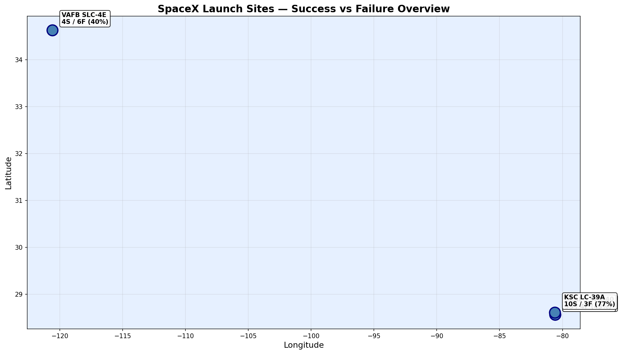
Folium Map Results — Launch Site Markers & Launch Records
All 4 SpaceX launch sites mapped with success/failure counts. Interactive version: output/launch_site_map.html
GitHub: https://github.com/RyanOrdonez/spacey-capstone

Slide 23
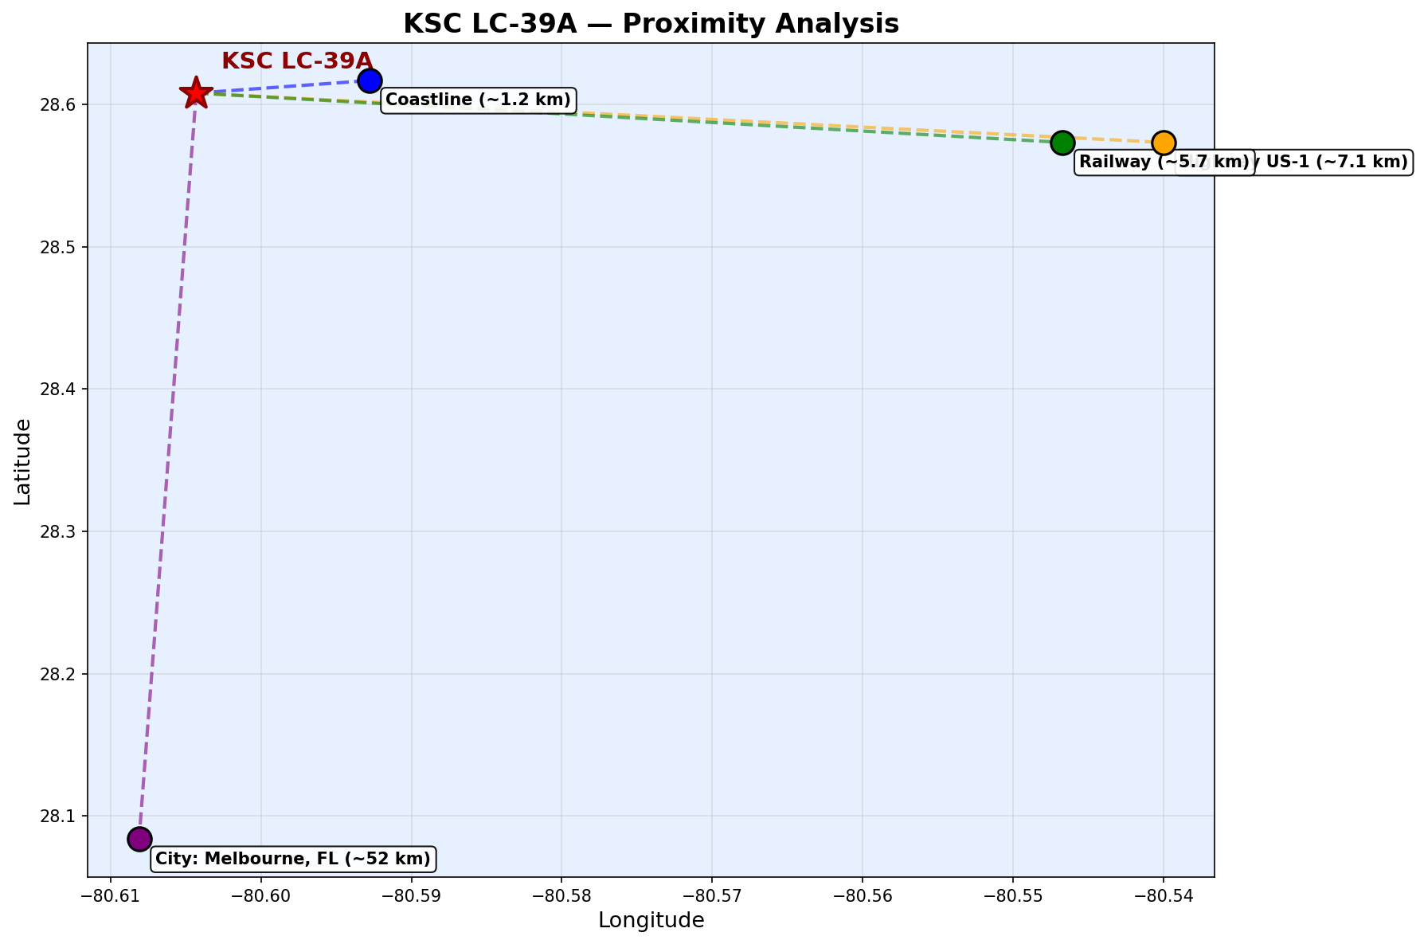
Folium Map Results — KSC LC-39A Proximity Analysis
KSC LC-39A is ~1.2 km from coast, ~7.1 km from highway, ~5.7 km from railway, ~52 km from nearest city. Interactive: output/ksc_proximity_map.html
GitHub: https://github.com/RyanOrdonez/spacey-capstone

Slide 24
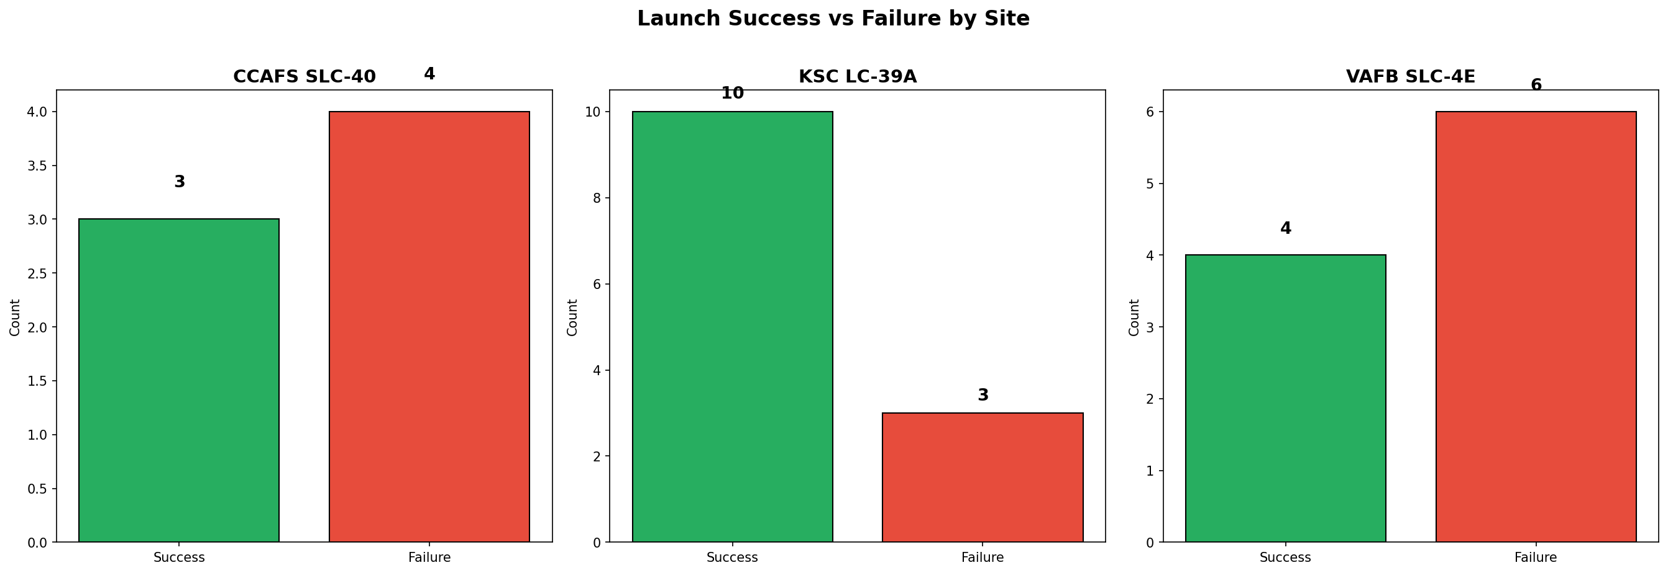
Folium Map Results — Success vs Failure by Launch Site
Success/failure breakdown per site. All sites are coastal for safety. KSC LC-39A has the most launches and highest success count.
GitHub: https://github.com/RyanOrdonez/spacey-capstone

Slide 25
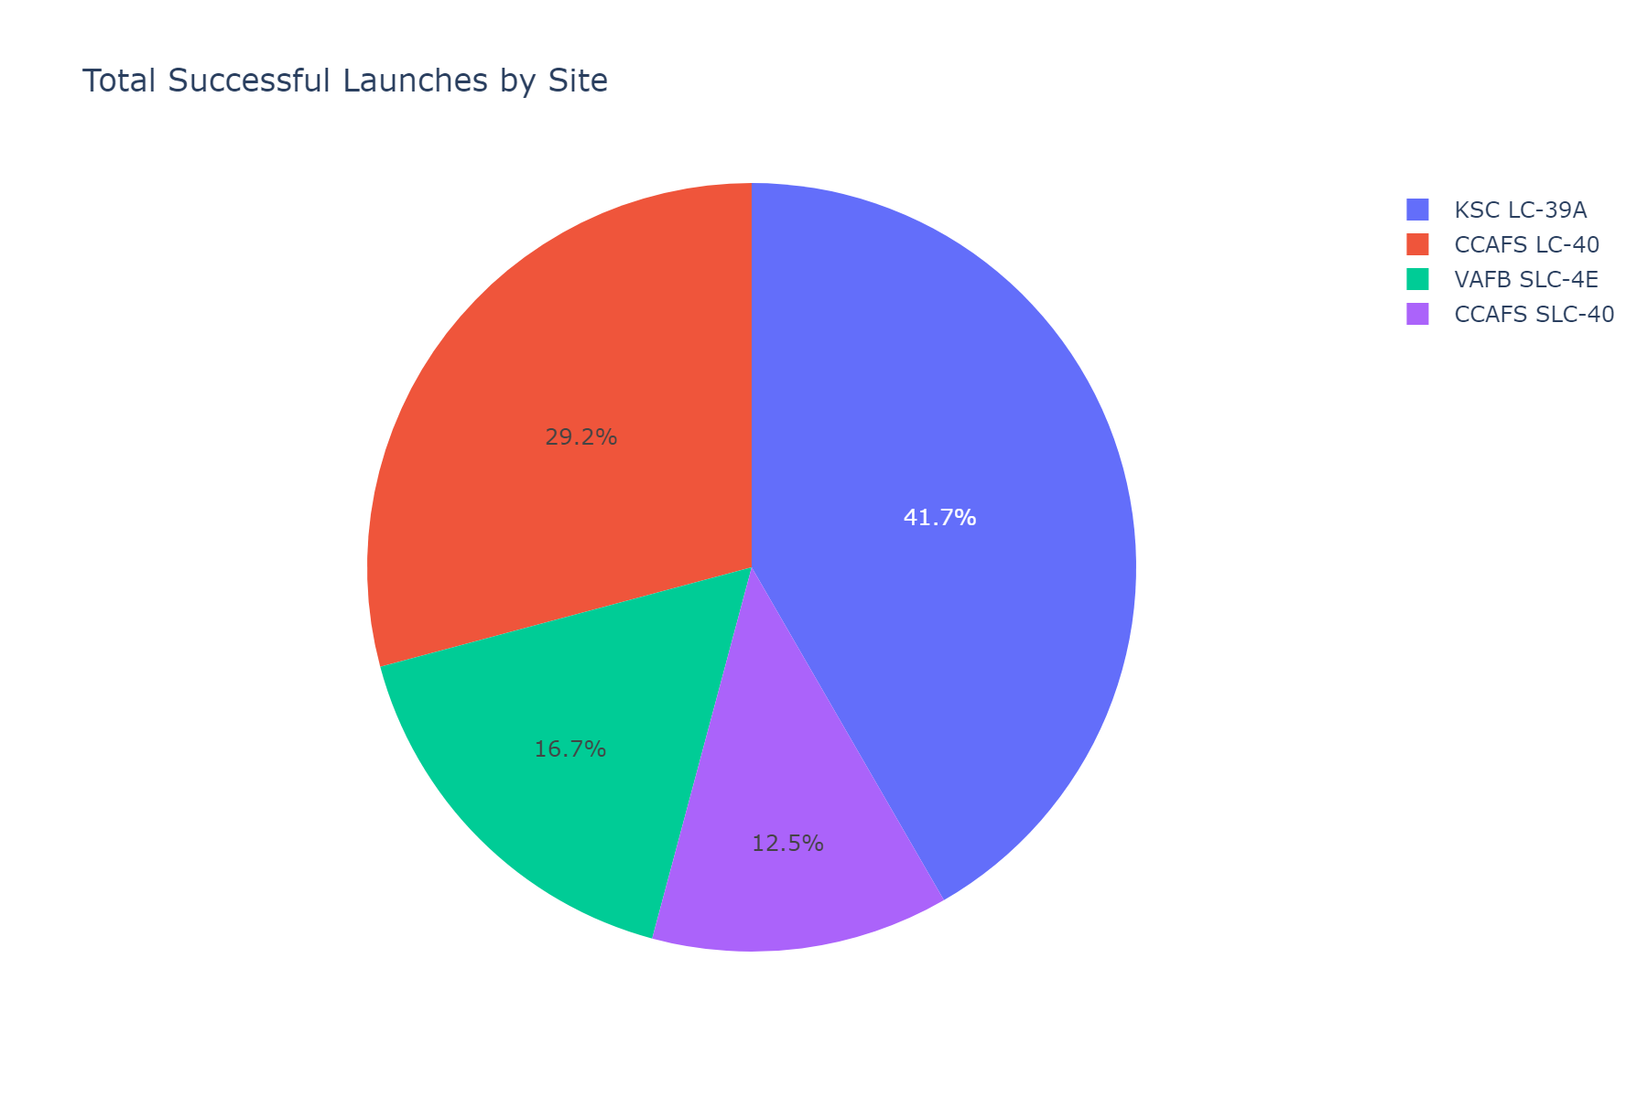
Plotly Dash Results — Success Pie Chart (All Sites)
Pie chart showing total successful launches distributed across all sites. KSC LC-39A contributes the most successes.
GitHub: https://github.com/RyanOrdonez/spacey-capstone

Slide 26
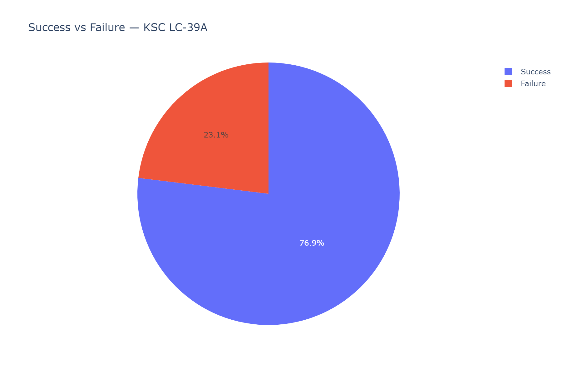
Plotly Dash Results — Success vs Failure Pie Chart (KSC LC-39A)
KSC LC-39A: 77% success rate — the most reliable launch site in the dataset.
GitHub: https://github.com/RyanOrdonez/spacey-capstone

Slide 27
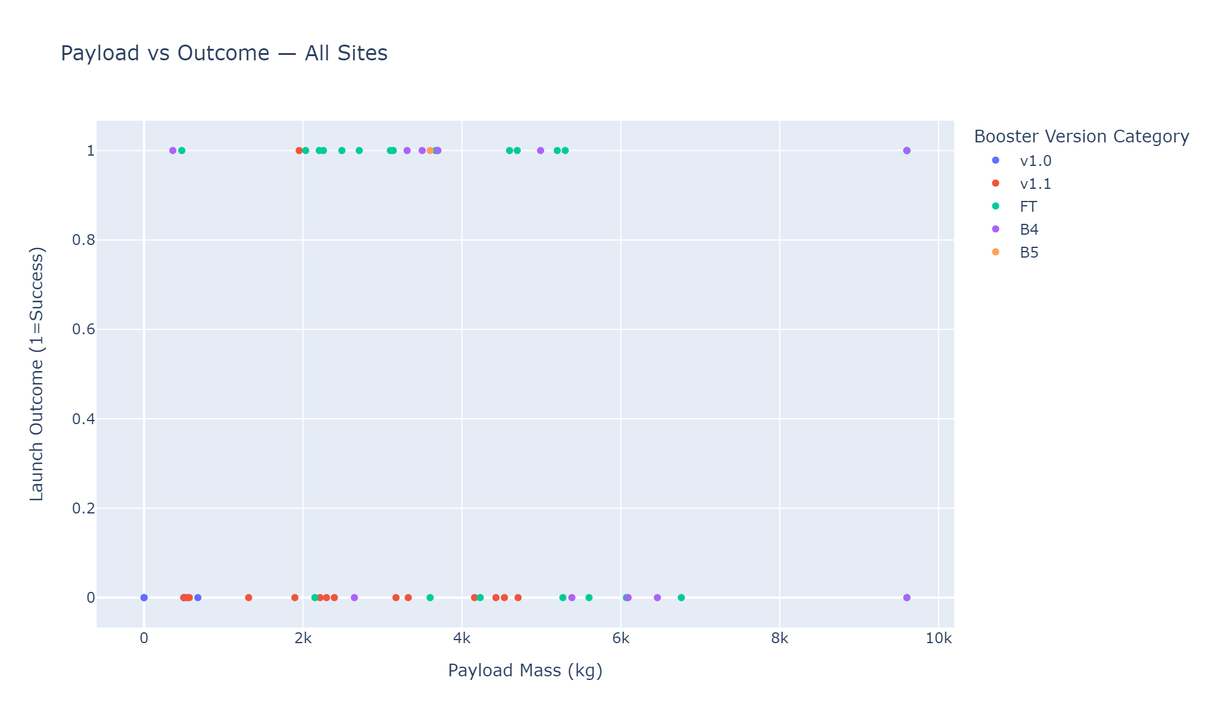
Plotly Dash Results — Payload vs Outcome Scatter (All Sites)
Scatter plot of Payload Mass vs Launch Outcome colored by Booster Version. FT and B5 boosters show higher success across payload ranges.
GitHub: https://github.com/RyanOrdonez/spacey-capstone

Slide 28
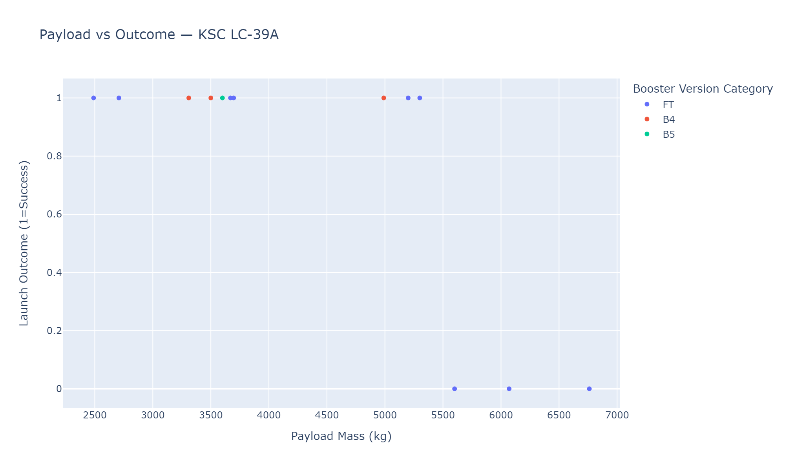
Plotly Dash Results — Payload vs Outcome Scatter (KSC LC-39A)
KSC LC-39A: Successful launches across all payload ranges. B5 boosters dominate recent successful missions.
GitHub: https://github.com/RyanOrdonez/spacey-capstone

Slide 29
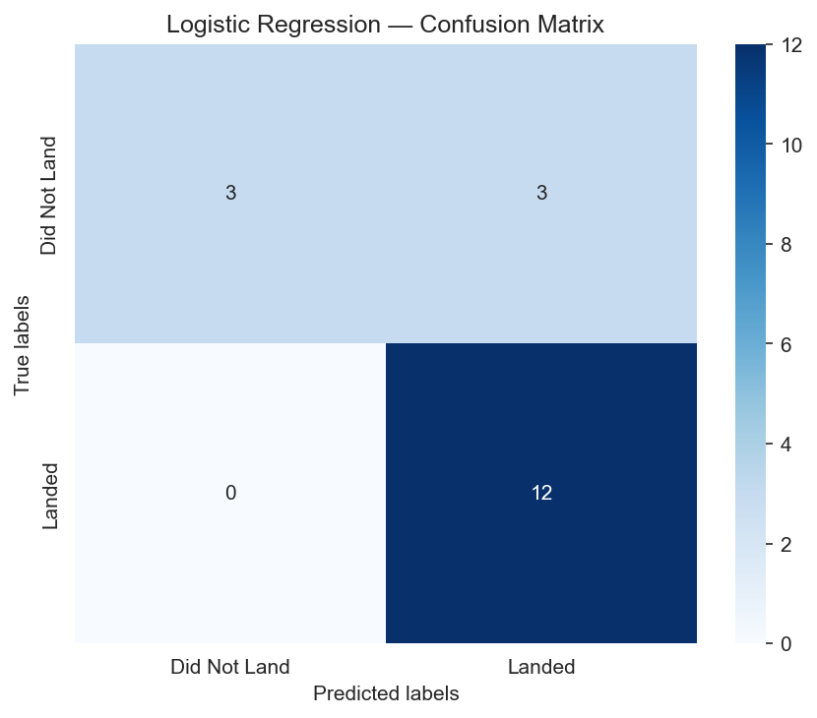
Predictive Analysis Results — Logistic Regression Confusion Matrix
Best params: C=0.01, penalty=l2, solver=lbfgs | CV Score: 84.64% | Test Accuracy: 83.33%
GitHub: https://github.com/RyanOrdonez/spacey-capstone

Slide 30
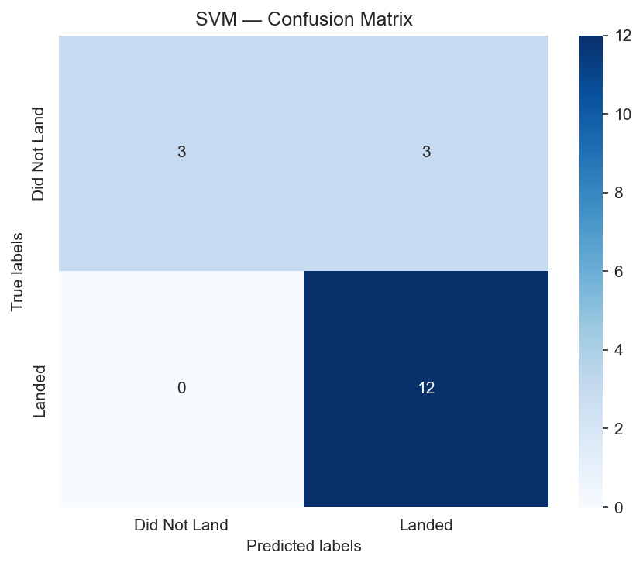
Predictive Analysis Results — SVM Confusion Matrix
Best params: kernel=sigmoid, C=1.0, gamma=0.032 | CV Score: 84.82% | Test Accuracy: 83.33%
GitHub: https://github.com/RyanOrdonez/spacey-capstone

Slide 31

Predictive Analysis Results — Decision Tree Confusion Matrix
Best params: criterion=entropy, max_depth=14, splitter=random | CV Score: 88.75% | Test Accuracy: 83.33%
GitHub: https://github.com/RyanOrdonez/spacey-capstone

Slide 32

Predictive Analysis Results — KNN Confusion Matrix
Best params: n_neighbors=10, algorithm=auto, p=1 | CV Score: 84.82% | Test Accuracy: 83.33%
GitHub: https://github.com/RyanOrdonez/spacey-capstone

Slide 33
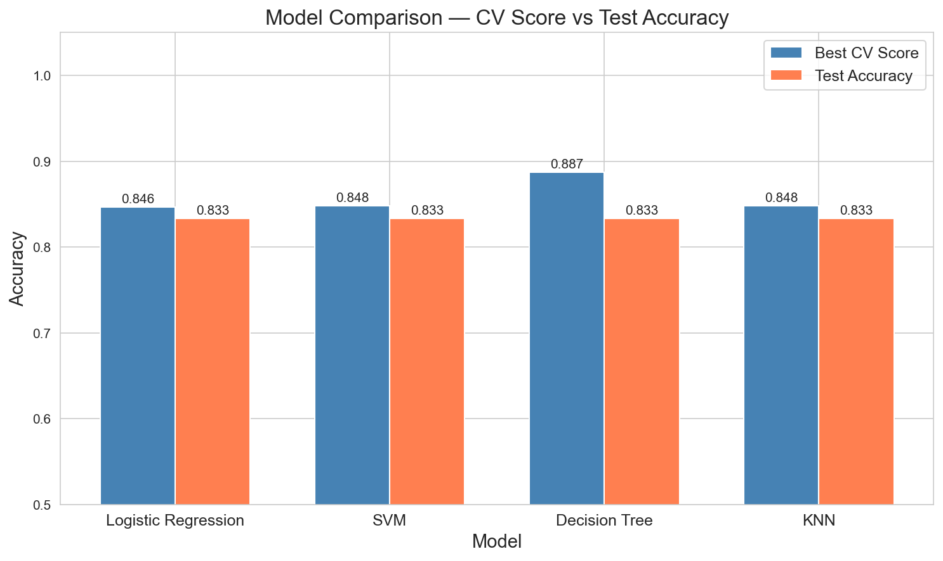
Predictive Analysis Results — Model Comparison
All 4 models achieve 83.33% test accuracy. Decision Tree has the highest CV score (88.75%) and is recommended as the best model.
GitHub: https://github.com/RyanOrdonez/spacey-capstone

Slide 34
Predictive Analysis Results — Best Model & Evaluation
Model Comparison Summary:
┌─────────────────────┬──────────┬──────────┐
│ Model │ CV Score │ Test Acc │
├─────────────────────┼──────────┼──────────┤
│ Logistic Regression │ 84.64% │ 83.33% │
│ SVM │ 84.82% │ 83.33% │
│ Decision Tree │ 88.75% │ 83.33% │
│ KNN │ 84.82% │ 83.33% │
└─────────────────────┴──────────┴──────────┘
Best Model: Decision Tree
• Highest cross-validation score (88.75%)
• Best params: criterion=entropy, max_depth=14
• Easily interpretable (feature importance)
• All models tied on test accuracy (83.33%)
• Small test set (18 samples) limits differentiation
Key Evaluation Insights:
• Confusion matrices show most errors are
false negatives (predicting failure when
actual outcome was success)
• This is the safer error type for SpaceY:
overestimating cost is better than
underestimating it
Recommendations:
• Use Decision Tree as primary predictor
• Ensemble methods (Random Forest, XGBoost)
could improve accuracy further
• Collect more data as SpaceX launches grow
• Feature importance analysis reveals Flight
Number and GridFins as top predictors
GitHub: https://github.com/RyanOrdonez/spacey-capstone

Slide 35
Discussion
Findings Summary:
1. SpaceX landing success has improved dramatically
from 0% (2010) to >80% (2020), driven by
engineering iteration and Block 5 boosters.
2. Launch site matters: KSC LC-39A consistently
outperforms other sites in success rate.
3. Orbit type is a strong predictor: LEO, ISS,
SSO, ES-L1, GEO orbits have highest success.
4. Grid fins and landing legs are strong indicators
of landing capability (enabled on later missions).
5. All ML models perform comparably (~83% accuracy)
with Decision Tree showing highest CV performance.
Limitations:
• Small dataset (90 samples, 18 test) limits
statistical power and model differentiation.
• Binary classification oversimplifies outcomes
(controlled ocean landings classified as success).
• Data only covers 2010-2020; recent Starship
developments may change competitive dynamics.
Future Work:
• Add weather data as features
• Use ensemble models (Random Forest, XGBoost)
• Time-series analysis of landing capability
• Cost-benefit analysis with prediction confidence
GitHub: https://github.com/RyanOrdonez/spacey-capstone

Slide 36
Conclusion & Innovative Insights
Conclusion:
We successfully built an end-to-end data science
pipeline that predicts Falcon 9 first stage landing
outcomes with 83.33% accuracy.
The Decision Tree classifier is recommended as the
primary model (CV: 88.75%). This prediction enables
SpaceY to estimate competitor launch costs and
develop competitive pricing strategies.
Business Impact:
• Predicted landing → bid ~$62M (reusable)
• Predicted failure → bid ~$165M (expendable)
• Savings per correct prediction: ~$103M
Innovative Insights:
1. Learning Curve Effect: SpaceX's landing
success follows a classic technology adoption
S-curve, suggesting competitors can replicate
this with sufficient investment and iteration.
2. Grid Fins as Innovation Marker: The
introduction of grid fins correlates strongly
with landing success improvement, representing
a key engineering breakthrough.
3. Geographic Strategy: All launch sites are
coastal and near the equator — a pattern SpaceY
should replicate for its own launch facilities.
4. Payload-Orbit Optimization: Matching payload
mass to favorable orbits (LEO, SSO) significantly
increases the probability of first stage recovery.
GitHub: https://github.com/RyanOrdonez/spacey-capstone

Slide 37
Appendix
GitHub Repository:
https://github.com/RyanOrdonez/spacey-capstone
Repository Structure:
spacey-capstone/
├── data/ CSVs, SQLite database
├── notebooks/ 7 Jupyter notebooks (01-07)
├── scripts/ Helper scripts
├── sql/ SQL query scripts
├── images/ Charts & confusion matrices
├── dash/ Plotly Dash application
├── output/ Folium HTML maps
├── slides/ PowerPoint & PDF
├── requirements.txt
└── README.md
Notebooks:
01_spacex_api_collection.ipynb
02_web_scraping.ipynb
03_data_wrangling.ipynb
04_eda.ipynb
05_sql_analysis.ipynb
06_interactive_visuals.ipynb
07_modeling.ipynb
Tech Stack:
Python, Pandas, NumPy, Matplotlib, Seaborn
Scikit-learn, BeautifulSoup, Requests
Folium, Plotly Dash, SQLite, Jupyter
Additional Charts:
• All 8 EDA charts saved in images/
• 4 confusion matrices in images/
• Model comparison bar chart in images/
• 4 Plotly Dash static charts in images/
• 3 Folium map visualizations in images/
GitHub: https://github.com/RyanOrdonez/spacey-capstone

